Slide 1

DATA ANALYTICS APPROACH
The Analytics Team
[Division Name] - [Engagement Manager], [Senior Consultant], [Junior Consultant]
KPMG Data Consulting Virtual Internship Project by Cheila Silva

Slide 2
AGENDA
Introduction
Primary Goals
Data Approach Overview
Data Quality Assessment
Data Exploration & Visualisation
Model Development
Interpretation
Next Steps in the Project

Slide 3
INTRODUCTION
Sprocket Central Pty Ltd is a long-standing KPMG client specialized in high-quality bikes and accessible cycling accessories for riders. The client has provided datasets regarding their existing customers and transaction history.
The purpose of the data analytics team:
Analyse the clients’ existing customers and transactions dataset to determine customer trends and behaviours;
Specify who Sprocket Central Pty Ltd’s marketing team should be targeting out of the new 1000 customer list as well as the broader market segment to reach out to.

Slide 4
PRIMARY GOALS
Understanding the team’s approach in the analysis of current customers demographics and attributes with the purpose of targeting high value customers and find which broader markets to target.
Present findings from this approach (Interpretation section)

Slide 5
DATA ANALYTICS APPROACH OVERVIEW
Data Quality Assessment
Assess quality of the datasets and perform necessary transformations and filters to arrange training dataset for exploration stages.
Data Exploration
Understand existing customers demographics, trends and behaviours and compare with new customers demographics.
Model Development
Customer segmentation using RFM Analysis to find which are the high value customers.
Interpretation
Visualise results from exploration and the high value customers found through the RFM analysis to compare with the new customer and find clients to target as well as the broader markets to target.

Slide 6
DATA QUALITY ASSESSMENT
Steps:
A quality assessment is performed to the datasets received based on the Standard Data Quality Dimensions and mitigation methods implemented.
Data is transformed, inconsistent formats are fixed, and data is filtered appropriately to obtain a training dataset ready for the data exploration and model development stages.

Slide 7
STANDARD DATA QUALITY DIMENSIONS FRAMEWORK
Standard Data Quality Dimensions |  | What to Check
Accuracy | Correct values | Incorrect data. How well does the information reflect reality?
Completeness | Data Fields with values | Missing data. Null values.
Consistency | Values free from contradiction | Are the datasets the same in every instance? Any inconsistent data?
Currency | Values up to date | Is the data current?
Relevancy | Data items with value meta-data | metadata: “simply stated is information that describes other data; essentially, data about data. It is the descriptive, administrative and structural data that defines assets.”
Validity | Data containing allowable values | Degree to which the data conforms to defined business rules or constraints. E.g. inconsistent formats.
Uniqueness | Records that are not duplicated | Do the datasets contain duplicates?

Slide 8
DATA QUALITY ASSESSMENT AND COURSE OF ACTION
Datasets​ | Quality Assessment | Mitigation | Recommendation
Transactions | Provides transaction history for the year 2017 Blank values detected across multiple columns; Inconsistent data formats (example: date fields as numbers) Customer IDs with no demographic or address information. | If only a small number of values are missing from columns, these will be filtered out from the training set. Otherwise, values will be imputed based on the existing data distribution of the training dataset. Columns will be converted to correct format. | Restrain from inputting incomplete data about customers and transactions into the datasets until all information is filled up unless it is not possible to do so. Ensure all datasets are from the same period and all customers are included across all datasets. Restrict the range of date of births by allowing only years from 1900’s and above. Use drop-down lists to ensure data is entered consistently. Ensure data types constraints are met for each table in the datasets.
Customer Demographic | Provides information for customers with ids 1 to 4,000 Blank values detected across multiple columns; Inaccurate data found (DOB from 1843) Columns with no valuable information (default column) Inconsistent categorical labels (Gender has values ‘M’ and ‘Male’ to label same attribute) | Missing values will be treated as mentioned above. Values deemed completely inaccurate will be cleaned from the data. Columns that provide no information will be excluded from the training set.
Customer Address | Provides information for customers with ids 1-4,000 Customer IDs with no demographic information and missing information for some IDs that do have demographics information. Inconsistent categorical labels (State has ‘VIC’ and ‘Victoria’ to label same attribute) | Extended values were replaced by their abbreviation to ensure consistency within column values. Only customer ids that are present across all datasets will be used.
New Customer List | List of 1,000 new customers and information about demographics and addresses. Some missing last_names

Slide 9
DATA EXPLORATION
Steps:
Feature construction: Create additional appropriate fields in order to segment customers and derive valuable insights.
Look at the existing and new customers distributions (based on age; wealth segmentation; job; gender; etc.) to allow for a better understanding of the customers at Sprocket Central.
Compare these distributions between the new and current customers datasets (find differences and similarities).
Important: Only current customers with transaction history will be considered so findings are based on customers that have purchased products from the client (hence 3486 current customers will be compared to the 1000 new customers)

Slide 10
FEATURE CONSTRUCTION
ADDING EXTRA FIELDS FOR INSIGHTS
Calculated Column | Datasets Applied To | Detail
Age | Customer Demographic New Customer List | Age on the 10th Jan 2018 to better reflect the age of the customer in the time of transaction (2017)
Age_Group | Customer Demographic New Customer List | Age grouped in 10s ( <20s, 20s, 30s, etc)
Profit | Transactions | Profit calculated as the difference between list price and standard cost price
Days_Since_Purchase | Transactions | Days since purchase as difference in days between transaction date and last day of transaction history (30th Dec 2017)

Slide 11
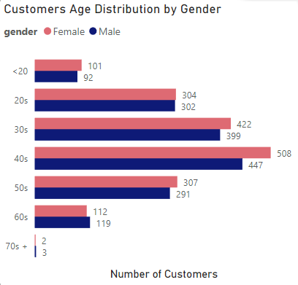
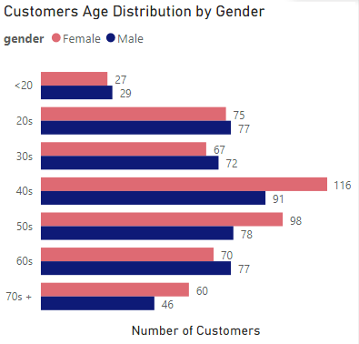
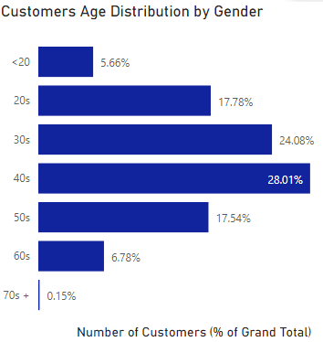
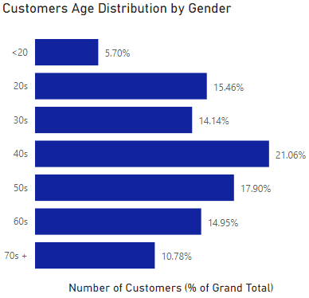
CUSTOMERS AGE DISTRIBUTION BY GENDER
Current Customers
New Customers
Observations:
Both current and new customers have a slightly higher number of female customers, seen the most in the 30s to 50s in current customers and the 40s to 50s (as well as 70s) in new customers.
About 53% of current customers are in the 30s and 40s age group, only about 7% are in their 60s and over, and less than 6% are under 20.
Age group in new customers is more spread out. New customers, like current customers, have less than 6% of customers under 20, but about 25% of new customers are in their 60s and over which is the triple of the % in current customers. Also 53% of new customers are in their 30s to 50s age group.
Summary:
New customers (in terms of percentage) tend to belong to older age groups and are more spread out across the different age groups.
There are more females than males
Customers (new and current) have a higher probability of being in their 40s.
  30s to 40s in current customers
  40s to 50s in new customers

Slide 12
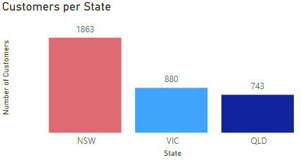
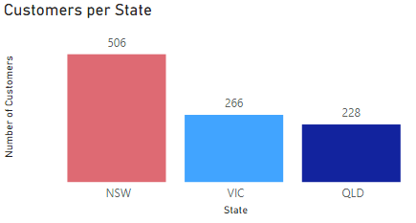
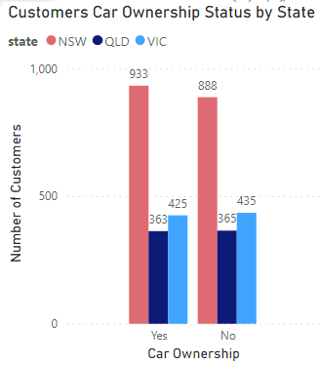
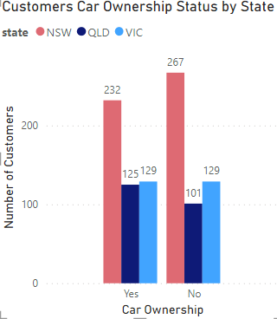
CUSTOMER DISTRIBUTION BY STATE
Current Customers
New Customers
Observations:
Most customers, new and current, reside in New South Wales.
Looking at car ownership by State:
  Current customers: Customers in Queensland and Victoria do not show much difference in the number of customers that own a car and do not own a car. In New South Wales, slightly less customers do not own a car.
  New customers: More customers in New South Wales do not own a car. And less customers in Queensland do not own a car. Victoria has the same number of customers that own and do not own a car.

Slide 13
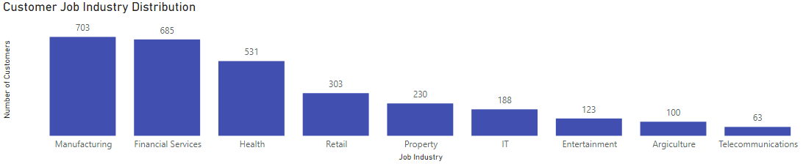
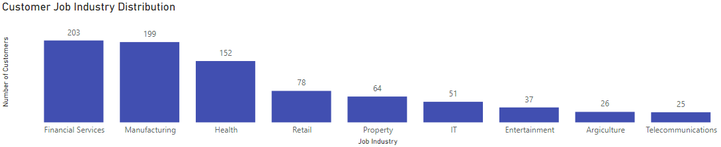
CUSTOMERS JOB DISTRIBUTION
Current Customers
Observations
Both current and new customers have a similar job distribution, the number of customers in Manufacturing and Financial Services being almost the same in both as well.
Top 3 known industries that customers belong to are: Manufacturing, Financial Services and Health.
New Customers

Slide 14
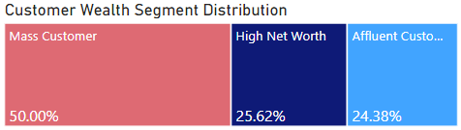
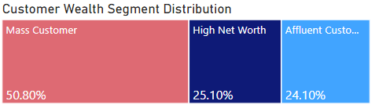
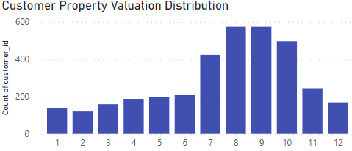
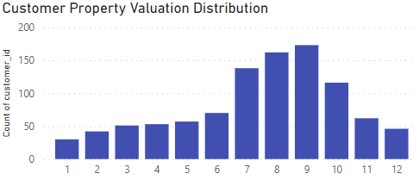
CUSTOMER WEALTH SEGMENT COMPARISON
CUSTOMER PROPERTY VALUATION DISTRIBUTION
Current Customers
New Customers
Observations:
Half the customers, both current and new, are Mass Customers.
High Net Worth and Affluent Customers occupy 25% each of the total population.
Current Customers
New Customers
Observations:
Most customers have property valuation scores between 7 and 10

Slide 15
MODEL DEVELOPMENT
Steps:
Feature construction: calculate Recency, Frequency and Monetary value for existing customers to find their RFM value
RFM Analysis: segment customers to find high-value customers by ranking them based on their assigned RFM value.

Slide 16
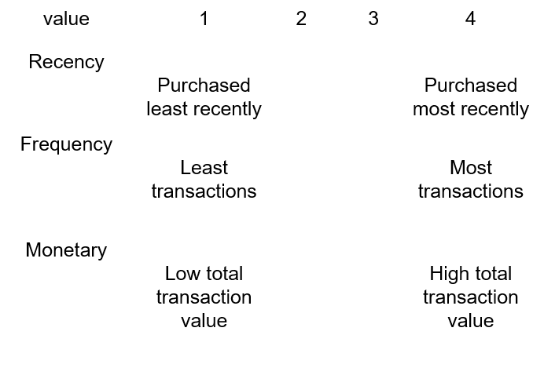
RFM ANALYSIS FOR CUSTOMER SEGMENTATION
WHAT IT IS
RFM analysis is a segmentation method used to analyse customer behaviour. RFM stands for Recency, Frequency and Monetary value. These are key customer traits, as they are indicators of how often, how recent and how much a customer spends, measuring their engagement with the organisation.
PURPOSE
By segmenting the customers we can analyse the characteristics of the different groups and formulate hypothesis on what new clients might be high-valued, thus, what customers should be targeted.

Slide 17
CUSTOMER TITLE & RANK ALLOCATION
Rank | Customer Title | Description | RFM value
1 | Champions | Bought recently, buy often, and spends the most. | 442 - 444
2 | Loyal Customers | Spend good money often, responsive to promotions. | 422 - 442
3 | Potential Loyalist | Recent customers but spend a good amount and bought more than once. | 344 - 422
4 | Recent Customers | Bought more recently, but not often. | 333 - 344
5 | Promising | Recent shoppers but haven’t spend much. | 313 - 333
6 | Customer Needing Attention | Above average recency, frequency and monetary values. May not have bought very recently though. | 234 - 313
7 | About to Sleep | Below average recency, frequency and monetary values. Will lose them if not reactivated. | 223 - 234
8 | At Risk | Spends good amount of money and purchases. | 211 - 223
9 | Can’t Lose Them | Made biggest purchases and often. Last purchase was a long time ago. | 124 - 211
10 | Hibernating | Last purchase was long back, low spenders, low number of orders. | 113 -124
11 | Lost | Lowest recency, frequency and monetary values. | 111 - 113

Slide 18
DATA INSIGHTS PRESENTATION
Created dynamic PowerBI dashboards present/visualise insights from the data exploration and model development stages of the project.
Explored new and current customers attributes and demographics - as well as how these relate to transactions made by current customers.
Presented high value customers from the current customers by rank - based on results from model development.

Slide 19
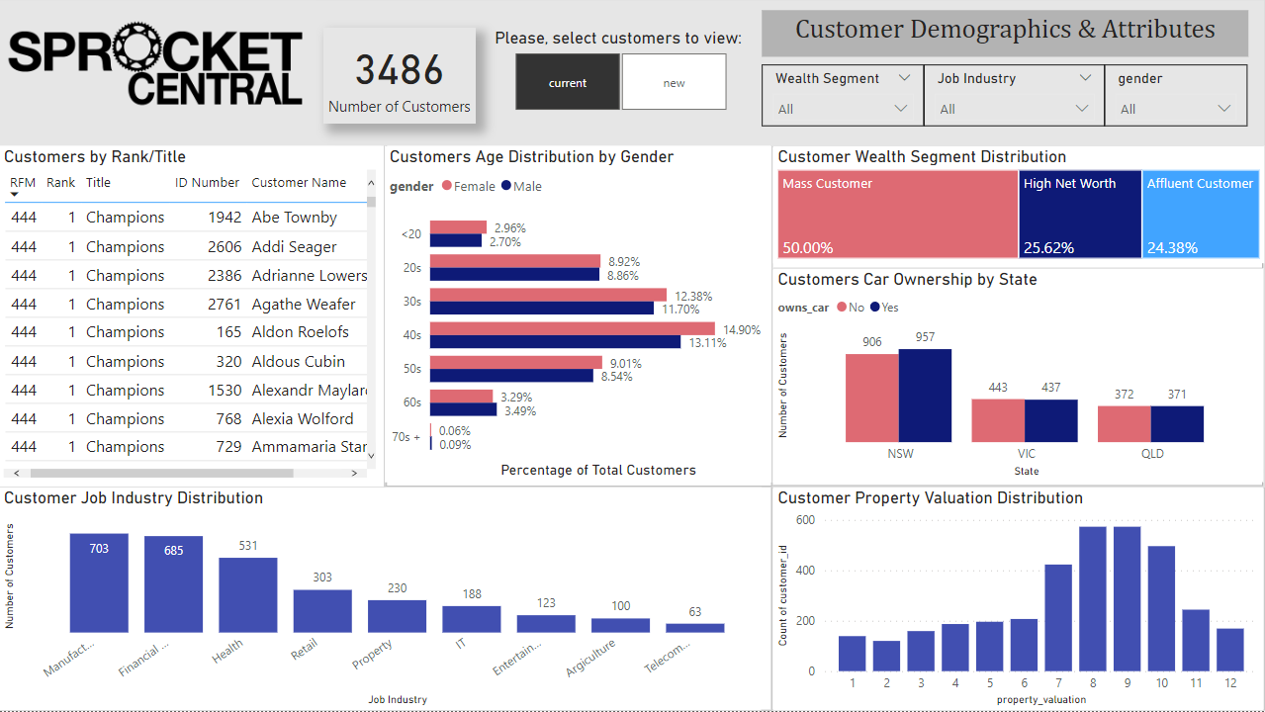
Current Customers Demographics & Attributes - Power BI Dashboard Snip used for Data Exploration

Slide 20
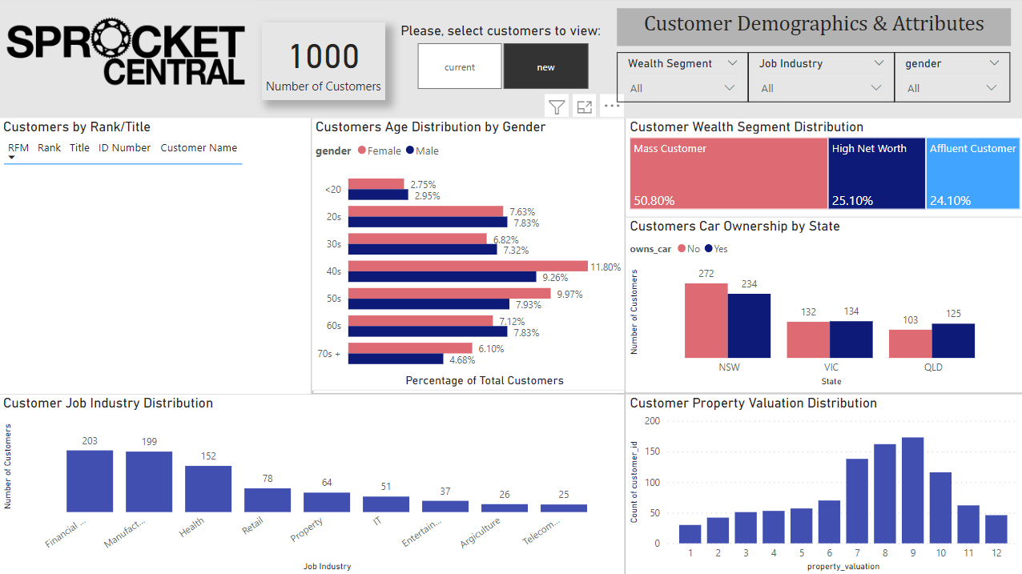
New Customers Demographics & Attributes - Power BI Dashboard Snip used for Data Exploration
Need to determine method to rank new customers based on insights from data exploration (check “Next Steps” session)

Slide 21
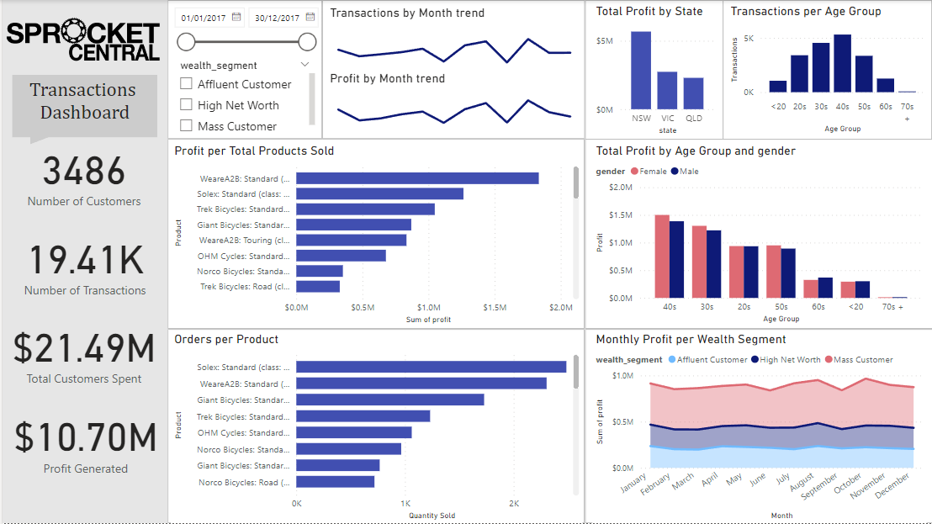
Current Customers Transactions - Power BI Dashboard Snip used for Data Exploration

Slide 22
INTERPRETATION
Found the broader markets to target based on transactions by looking at transactions based on different customer attributes.
Determined high value customers from existing customers dataset.
Utilise findings to find the broader markets to target based on customers demographics and attributes (Section: Interpretation).
Utilise findings to find the broader markets to target based on customers demographics and attributes (Section: Interpretatio

Slide 23
MARKETS TO TARGET
Based on initial data exploration of customer attributes and demographics, most of current customers with transaction history in 2017 tend to belong to the following markets:
Wealth Segment = Mass Customer;
Gender = Female;
Age Group = 30s to 40s;
Job Industry = Manufacturing, Financial Services and Health.
Property Evaluation = Scores 7 to 10
Based on the transaction dashboard these groups are also the ones who tend to buy the most and spend the most.
Seeing as new and current customers have similar distribution, high value customers from the new customer list will also belong to these markets.

Slide 24
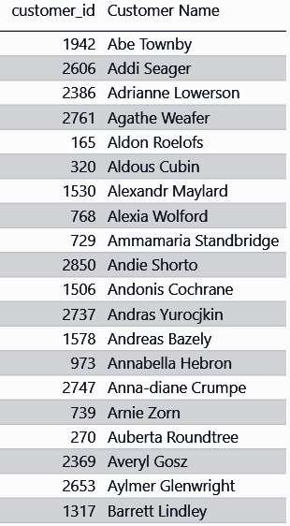
HIGH VALUE CURRENT CUSTOMERS BY RANK
Rank | Customer Title | RFM value | Customer Count
1 | Champions | 442 - 444 | 318
2 | Loyal Customers | 422 - 442 | 317
3 | Potential Loyalist | 344 - 422 | 318
4 | Recent Customers | 333 - 344 | 317
5 | Promising | 313 - 333 | 316
6 | Customer Needing Attention | 234 - 313 | 317
7 | About to Sleep | 223 - 234 | 317
8 | At Risk | 211 - 223 | 317
9 | Can’t Lose Them | 124 - 211 | 315
10 | Hibernating | 113 -124 | 317
11 | Lost | 111 - 113 | 317
SQL NTILE function was used to calculate recency, frequency and monetary scores in order to find the overall RFM value, and was then also used to segment the customers based on RFM value attained.
Top 15 customers are shown based on RFM value (PBI dashboard shows all customers in order of rank).
High RFM = Higher Rank (1 being the highest)
Observations:
Customer titles are divided almost equally throughout the current customers with transaction history available.
High value customers:
Champions and Loyals Customers are the clients that based on their RFM value bring the most value to the client in terms of profit generated (they have bought recently, more frequency and spent the most)

Slide 25
NEXT STEPS
Determine method to use what we know about high value customers to determine which of the 1000 new customers to target;
Update sections “Model Development” and “Interpretation” to describe the method and present findings

Slide 26
THANK YOU

